Slide 1
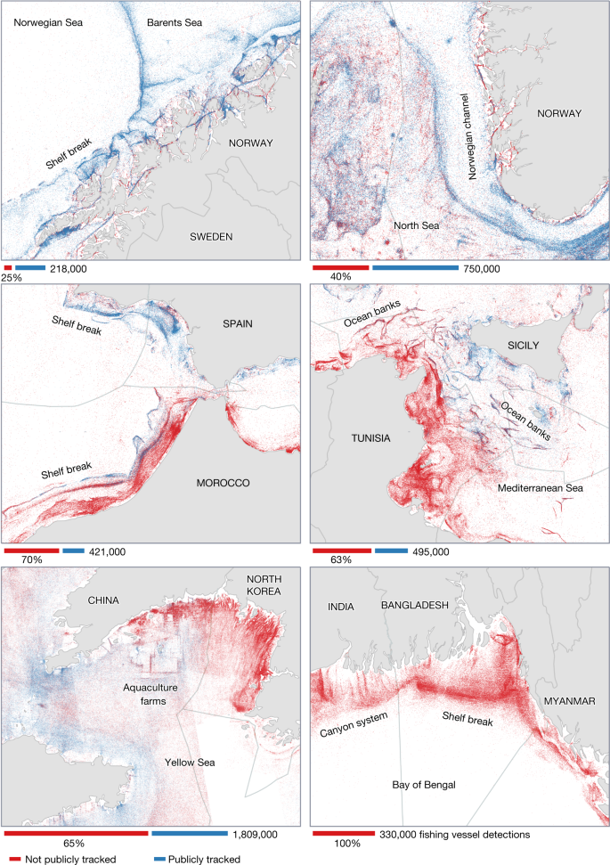
Map Design and Statistical Visualisation ENVS456 – week 2 Gabriele Filomena
Source: https://www.nature.com/articles/s41586-023-06825-8

Slide 2
Agenda
Visualisation
Geovisualisation
Symbols
Choropleths
Cartograms

Slide 3
Visualisation

Slide 4
What?
“Visual representations of datasets designed to help people carry out tasks more effectively”
Munzner (2014)
Notes:
Encoding/dataset

Slide 5
When?
Keep the human in the loop
Augment memory/internal representation
Ask new questions rather than answering existing ones

Slide 6
Why?
Bridges human and machine
Relies on vision
External representations work around limits of internal cognition/memory
Notes:
Vision is more powerful then other senses
Machine can do it better than us

Slide 7
How?
what-why-how
↓
data-task-idiom
Most ineffective designs are due to a poor match
Domain-specific →Abstract form
Notes:
Visualisation is an abstraction of data/how to do it
Building blocks
- information: certain options/routes (textual vs geographical)
- why: task (filtering/augmenting)
- How → idiom, types of visualisation (e.g. a map/chart bar is an idiom).
Techniques
Usually it is taken from an applied route
It helps connect the dots

Slide 8
How?
Vis is multi-use:
Exploring
Checking pre-conceived ideas
Long-term use in workflows/processes
Presentation
A tool that serves well for one task can be poorly suited for another
Notes:
Critical processes/decisions

Slide 9
The most extensive data maps […] place millions of bits of information on a single page before our eyes.
No other method for the display of statistical information is so powerful
Tufte (1983)

Slide 10
Geovisualisation

Slide 11
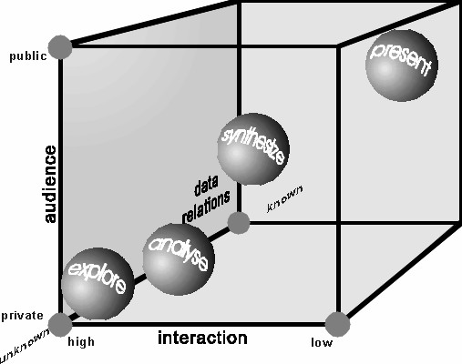
The Map Cube
http://cartography.tuwien.ac.at/wordpress/wp-content/uploads/2013/01/cartotalk-corne-van-elzakker.pdf

Slide 12
Designing Good Maps
Knowledge of what is being plotted
Target audience
Degree of interactivity
MacEachren & Kraak (1997)

Slide 13
When to Use Mapping
Capacity to communicate large quantities of information quickly and intuitively.
Maps can be analytically powerful and aesthetically engaging.
Spatial patterns and spatial variation are the priority
When communicating place, space and location.
Notes:
Maps weaker for communicating other important variable like magnitude, direct numerical comparisons and change over time.

Slide 14
Consider the Audience
Research Audience: depth, insight and analytical capabilities.
General Public: accessible and engaging.
Promotional Context: used to promote a new project/dataset/paper. Eye-catching.
Government & Policy Audience: support decision making

Slide 15
Design Principles
Legibility: Maps should be clear and straightforward
Accuracy: maps should be a consistent representation of reality.
Aesthetic Appeal: visually engage the audience
Important: Sourcing
Notes:
Legibility depends on many decisions, such as the scale of the data, and good graphic design.
Not just that features should be in the correct location,
Ref data sources, include a legend defining the classification.

Slide 16

Map Critically
Power of Mapping: Audience assume data is true
From minor errors, to intentional misrepresentations (marketing and propaganda)
Representation and Omission: Map authors have power over what is on and off the map
Notes:
Following Best Practice
No easy answers, following map design best practice helps.
More profound response to include multiple representations and voices. See Community Mapping and Critical GIS movements for this approach.
. Can be biased and fail to capture urban diversity. Also possible through map design choices to misdirect viewers.

Slide 17
Symbols

Slide 18
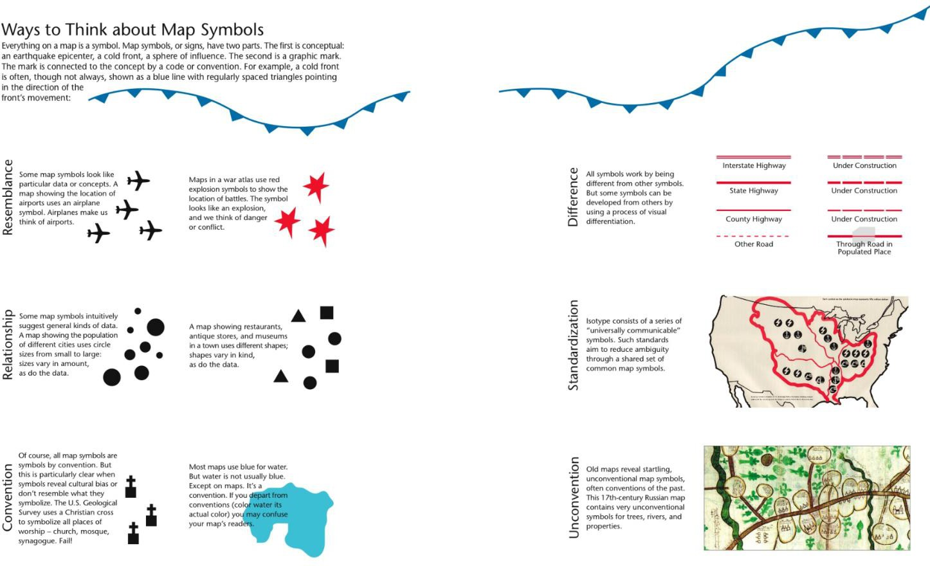
Lines and Symbols
Source: Krygier and Wood 2011

Slide 19
Colour Choropleths

Slide 20
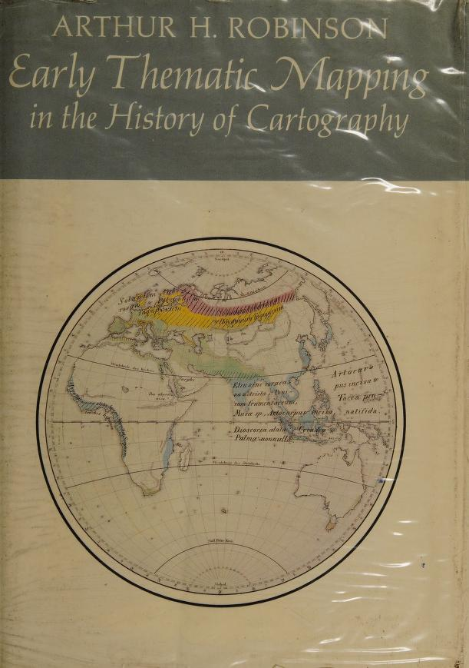
Choropleths
Thematic Maps in which values of a variable are encoded using a colour gradient

Slide 21
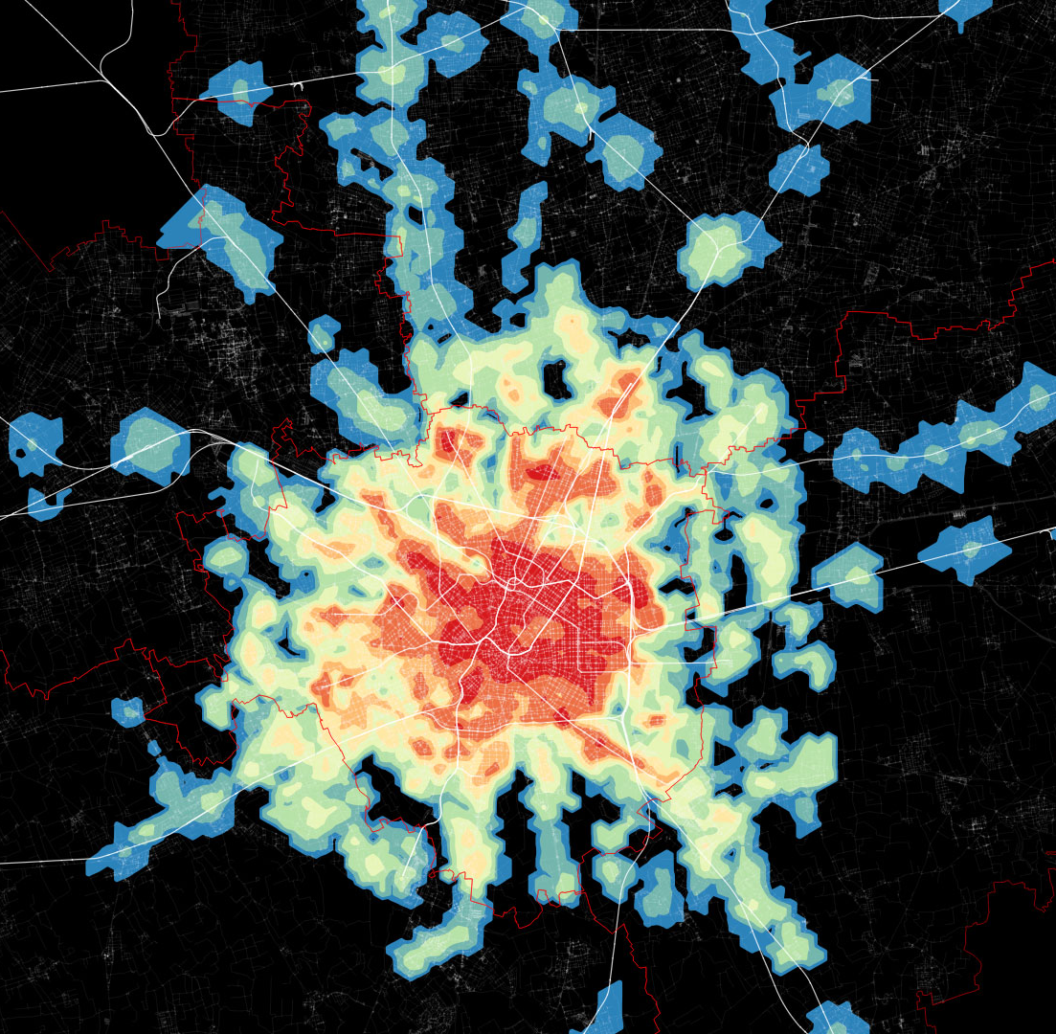
How?
Encode value using the colour channel
Values are classified into groups (bins)
Information loss as a trade off for simplicity

Slide 22
Classification choices
N. of bins:
Trade-off: detail vs cognitive load
Exact number depends on purposes
Usually not more than 12
How to bin?
Colours

Slide 23
Unique values
Categorical data
No gradient
Examples: Religion, country of origin…

Slide 24
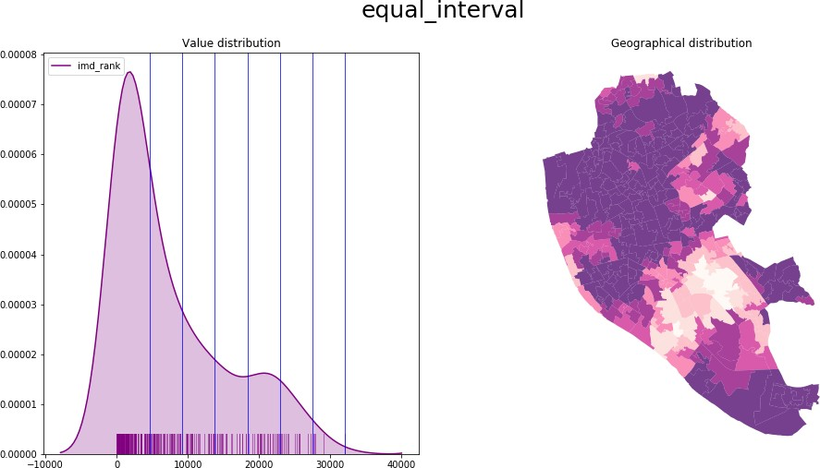
Equal Intervals
Take the value span of the data to represent and split it equally
Splitting happens based on the numerical value Gives more weight to outliers if the distribution is skewed

Slide 25
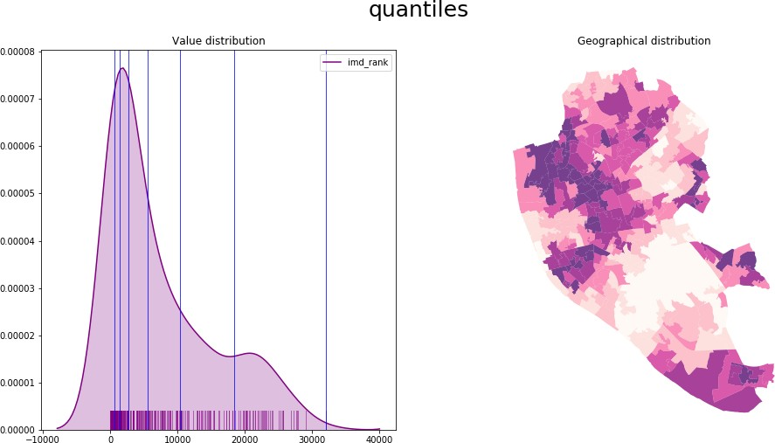
Quantiles
Regardless of numerical values, split the distribution keeping the same amount of values in each bin
Splitting based on the rank of the value
If distribution is skewed, it can put very different values in the same bin

Slide 26



Color schemes
Categories, non-ordered
Graduated, sequential
Graduated, divergent
Check ColorBrewer for guidance
Notes:
Align with your purpose

Slide 27
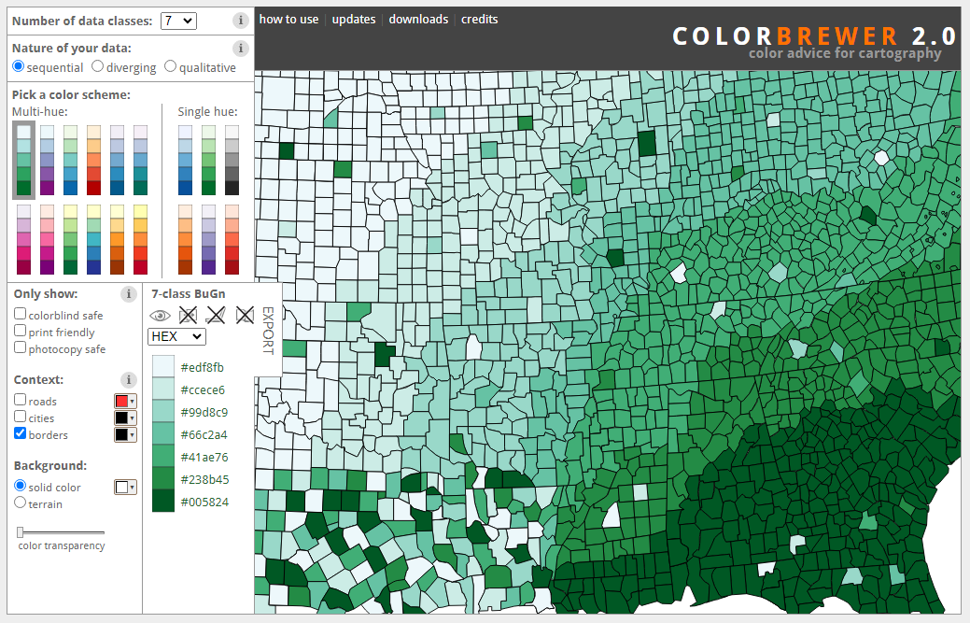
Notes:
Align with your purpose

Slide 28
Size Cartograms

Slide 29
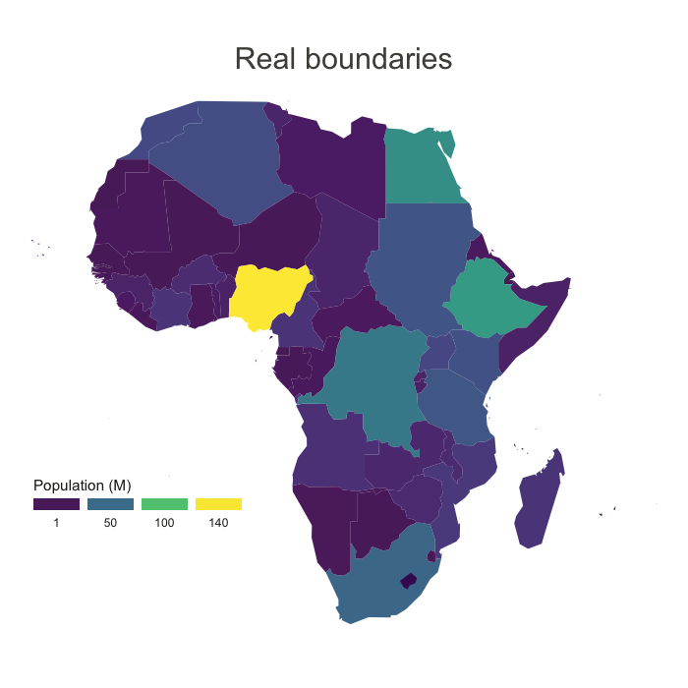
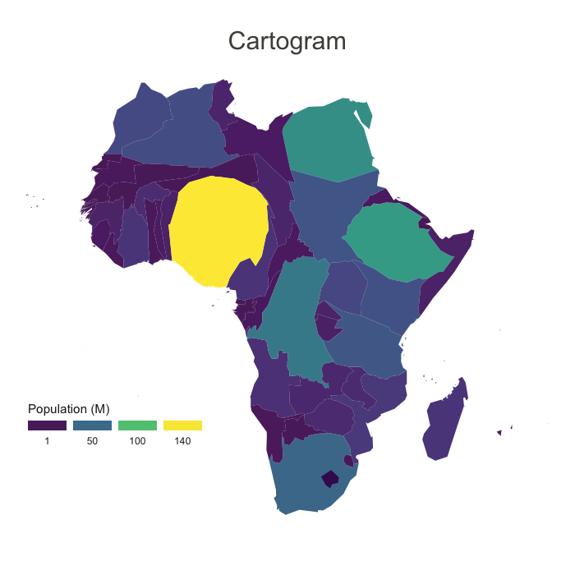
https://www.data-to-viz.com/graph/cartogram.html
Notes:
Align with your purpose

Slide 30
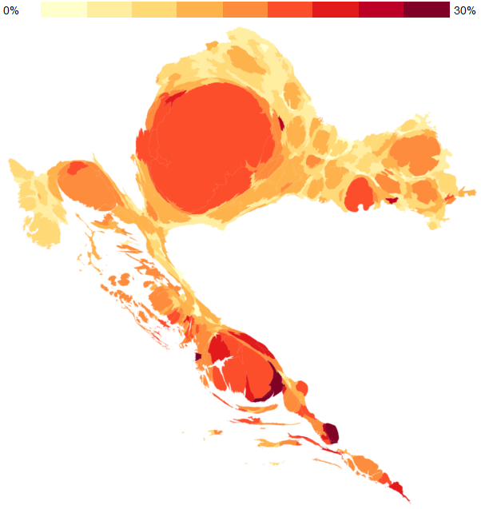
Source:
Dejan Vinkovic: work at http://oraclum.eu/cartograms-of-election-results/
Notes:
Align with your purpose

Slide 31
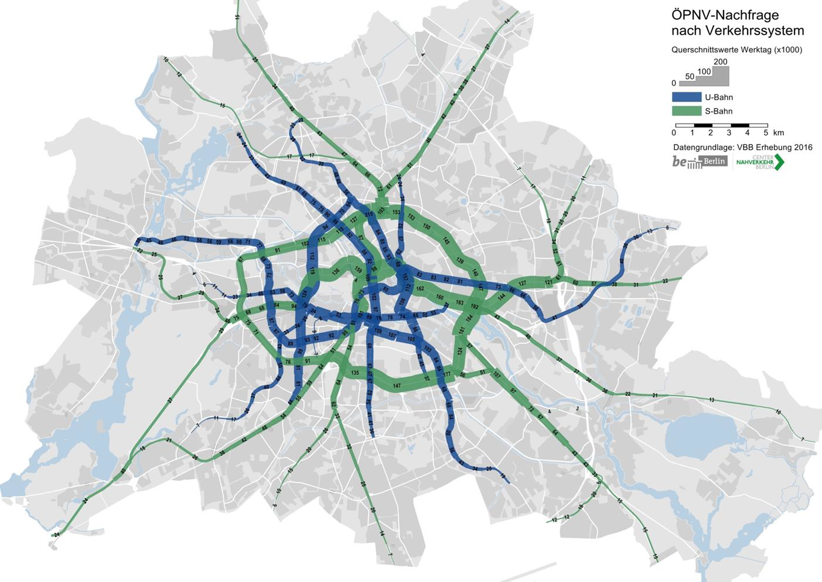
Source (p.6): https://www.berlin.de/sen/uvk/_assets/verkehr/verkehrsplanung/oeffentlicher-personennahverkehr/nahverkehrsplan/broschure_nvp_2019_anlage_2.pdf
Notes:
Align with your purpose

Slide 32
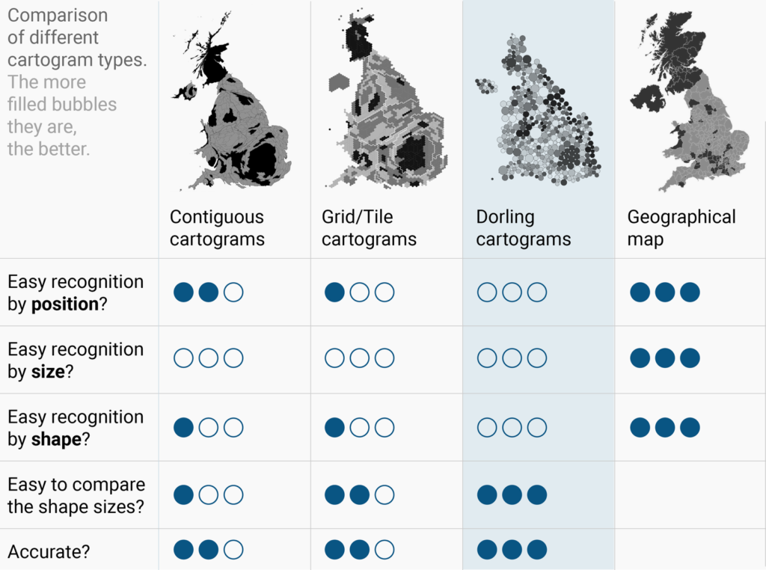
Source:
Lisa Charlotte Muth: https://blog.datawrapper.de/cartograms/
Notes:
Align with your purpose

Slide 33
Final Remarks

Slide 34
Global Projections
Different projections cause large distortions in sizes and shapes.
Consequences on aesthetics of and political perceptions.
Standard Mercator projection used by Google shrinks countries at the equator.
Notes:
distorting size of global South.

Slide 35
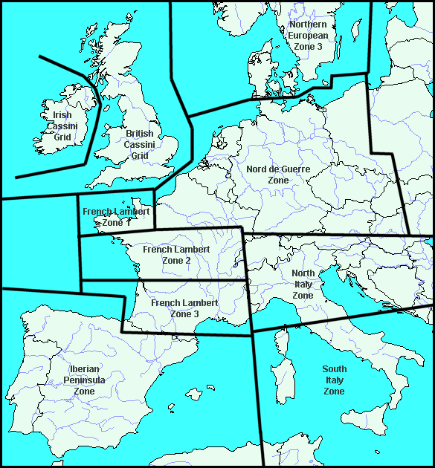
Local Projections
Most countries release data using national coordinate system and projection (e.g. British National Grid).
In larger countries there can be more than one projections
Standardisation minimises issues for analysis at the country level.
Source: https://www.echodelta.net/mbs/eng-overview.php
Notes:
All spatial data is a representation of the complex three dimensional earth. Need to use a reference model, called a Coordinate Reference System (CRS). To display data on a map, three dimensional globe has to be converted into two dimensions. Method for doing this called a projection.

Slide 36
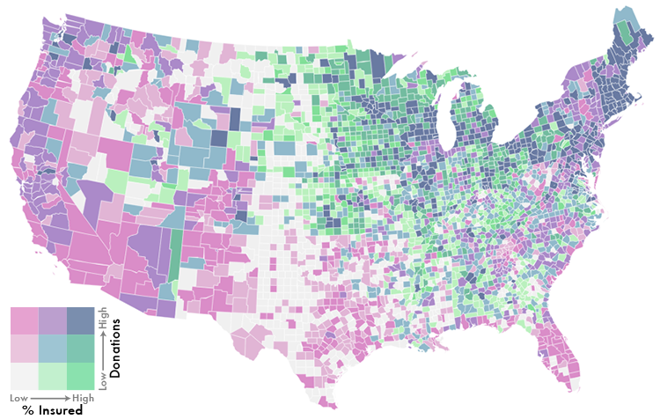
Bivariate Maps
Source: https://www.echodelta.net/mbs/eng-overview.php
Notes:
All spatial data is a representation of the complex three dimensional earth. Need to use a reference model, called a Coordinate Reference System (CRS). To display data on a map, three dimensional globe has to be converted into two dimensions. Method for doing this called a projection.

Slide 37
Tips
Think about the purpose of the map
Determine the best visualisation by trying different classification alternatives
Combine (Geo)visualisation with other statistical devices
Less is better

Slide 38
References
Tamara, Munzner. Visualization Analysis and Design. CRC Press, 2014
Tufte, Edward R. The visual display of quantitative information. Graphic Press, 1983
Krygier, John and Wood, Deni. Making maps: A visual guide to map design for GIS (2nd edition). The Guilford Press, 2011.
MacEachren, Alan M., and Menno-Jan Kraak. Exploratory cartographic visualization: advancing the agenda. Computers & geosciences 23, no. 4 (1997): 335-343.

